Slide 1







UNSKILLED
Societe Generale
SENTRAX: AI-AUTOMATED NETWORK PENTESTING

Slide 2

UNSKILLED
Societe Generale
Challenge Overview
1) Rising Cyber Threats & Limited Pentesters
2) Organizations face an explosion of attack vectors—IoT, cloud misconfigurations, zero-days—while skilled pen testers remain in short supply.
3) Manual workflows across reconnaissance, exploitation, and reporting consume weeks per engagement and are prone to human error.
4) Need for Automation + AI
5) Automate repetitive tasks to free pen testers for high-value analysis.
6) Leverage Large Language Models to interpret raw tool output and recommend next steps.
7) Deliver actionable reports in minutes, not days.

Slide 3


UNSKILLED
Societe Generale
Objectives
SENTRAX
1) Full-Lifecycle Automation:
Reconnaissance → Scanning → Exploitation → Persistence → Cleanup → Reporting
2) LLM-Driven Intelligence:
GPT-4 analyzes Shodan & Nmap data, suggests exploits, crafts remediation steps, and writes executive-ready reports.
4) Modular, User-Friendly Platform
5) Plug-and-play modules for new tools (e.g., Nessus).
6) One-click “Full Workflow” or step-by-step phase execution.
7) Intuitive React/Tailwind interface with dark-theme, real-time logs, progress bars.

Slide 4
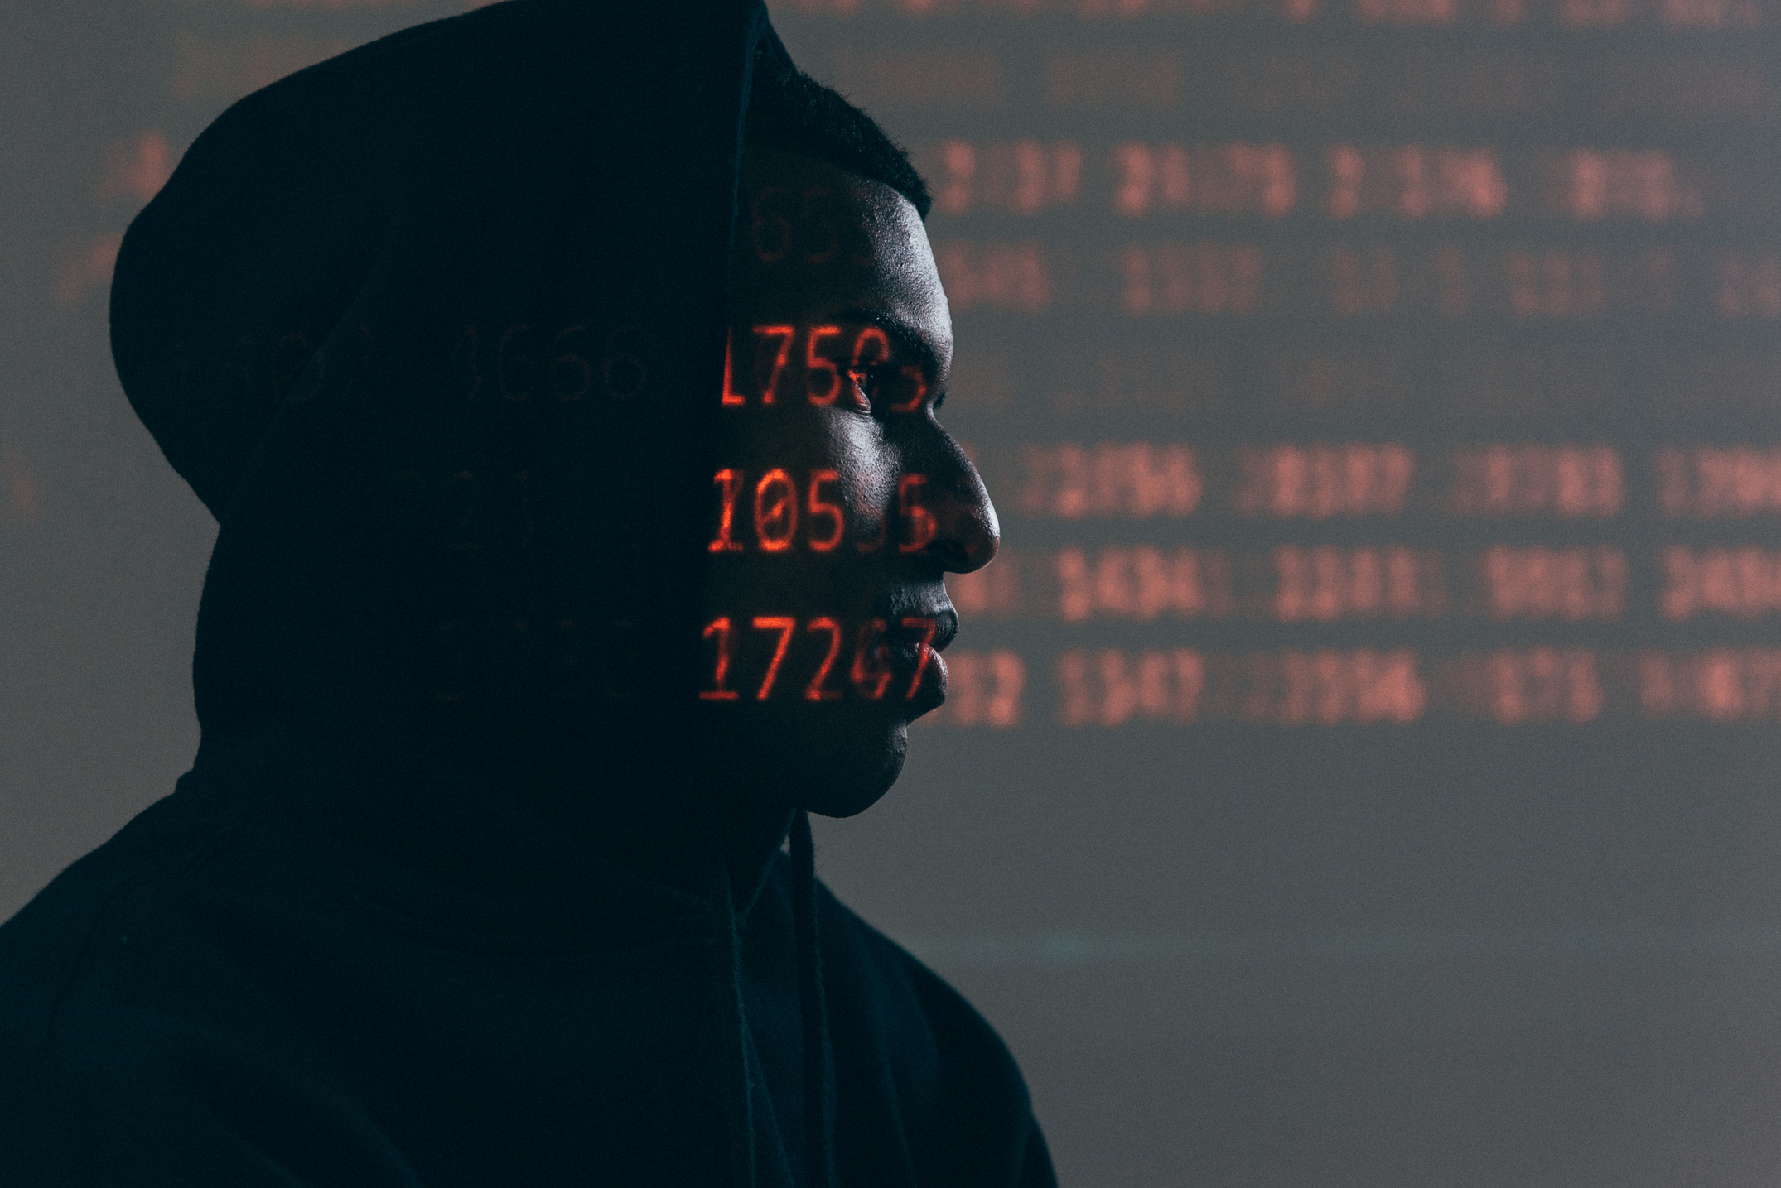
UNSKILLED
Societe Generale
Architecture
- Orchestrates six pen test phases via Python - Single-page app with tabs for Dashboard, AI Workflow, Phases, Risk Engine, Report
- Modules in backend/pen test/: recon.py, scan.py, exploit.py, persist.py, cleanup.py, report.py - Real-time terminal-style logs and progress indicators
- utils/gpt_client.py wraps GPT-4 API calls - Templates for Web App, Stealth, Comprehensive workflows
- CORS & proxy configured to serve UI at 5173 - Downloadable PDF/HTML report export
- .env keys: OPENAI, SHODAN, MSF_RPC_PASSWORD - Priority modes: Stealth, Aggressive, Comprehensive

Slide 5
UNSKILLED
Societe Generale
Key Features
1) Recon via Shodan + GPT-4
2) Automated host/profile data retrieval → AI summary of open ports, services, known vulnerabilities.
3) Nmap Scanning + AI Insights
4) Version & OS detection → GPT-4 recommends scan refinements and next-phase strategies.
5) Metasploit Automation
6) GPT-4 selects exploit modules & parameters → Metasploit RPC executes payload with minimal manual coding.
7) AI Risk Engine & Remediation
8) CVSS-based scoring enriched by business-impact metrics (Confidentiality, Integrity, Availability).
9) GPT-4 suggests tailored remediation steps, prioritized by severity.
10) Professional Report Generation
One-click GPT-4–authored executive summary, technical findings, risk matrix, and remediation roadmap.

Slide 6
UNSKILLED
Societe Generale
Use Cases
Enterprise Security Assessments:
* Schedule daily/weekly scans across corporate IP ranges; auto-generate executive reports for CISOs.
DevSecOps Integration:
* Embed sentraX into CI/CD to auto-scan new builds. Fail builds on critical vulnerabilities.
Managed Security Service Providers (MSSPs):
* Offer on-demand pentesting with AI insights for SMB clients.
Continuous Monitoring:
* Real-time alerts on new exposures; auto-remediate low-risk findings.

Slide 7


UNSKILLED
Societe Generale
SAAS SUBSCRIPTION
Tiered by monthly IP-scan volume, AI-query credits, and premium templates
ENTERPRISE LICENSE
On-prem deployment, perpetual license with annual maintenance fee.
PROFESSIONAL SERVICES
Custom template development, integration support, and pentesting best-practice training.
Monetization
THE FUTURE VISION...

Slide 8
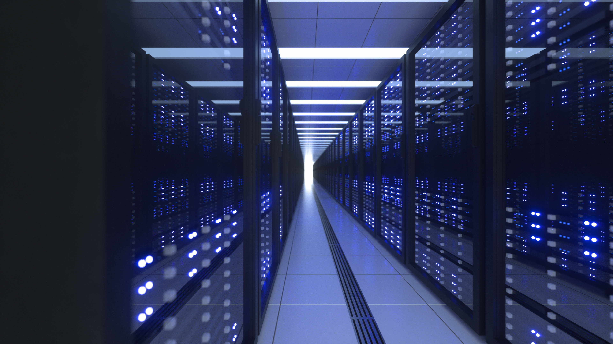
UNSKILLED
Societe Generale
Dashboard: Enter targets → Click “Start Pentest” → Watch terminal-style logs update live.
STEP 1:
LIVE DEMO SEQUENCE
AI Workflow: Select “Stealth” template → GPT-4 customizes Nmap arguments → Confirm & run.
STEP 2:
Report: View risk matrix → Download PDF with executive summary & remediation plan.
STEP 3:

